Slide 1
Analyzing the 2020 Election
Susan Rico, Sean O’neil, Quinn Knudsen
IST 659
Notes:
1

Slide 2
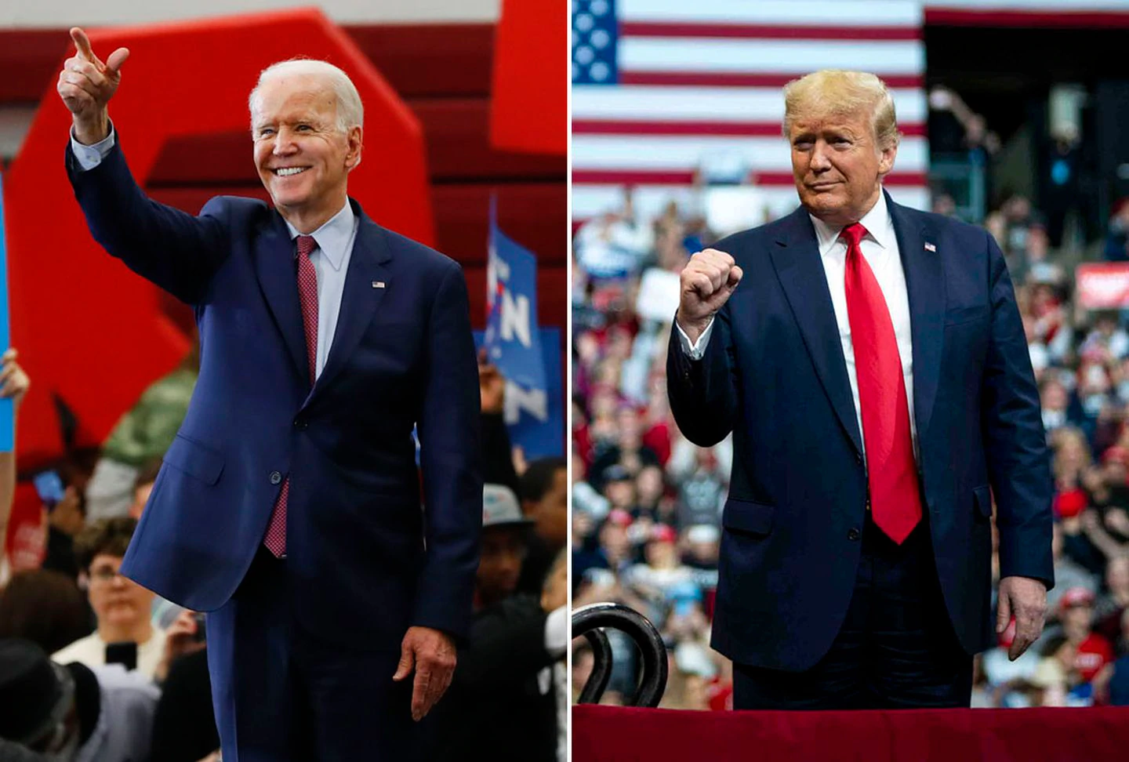
Rationale
2020 is a tumultuous year in many regards and a period of radical change in human behavior and society at large. Central to change is policy. Coincidentally, 2020 is also a year of the presidential election in the United States, making it a timely endeavor to explore, monitor, and project the manifestation of the pivotal election happening in November.
Source: https://www.bostonglobe.com/2020/04/07/metro/shortest-presidential-election-ever/
2

Slide 3
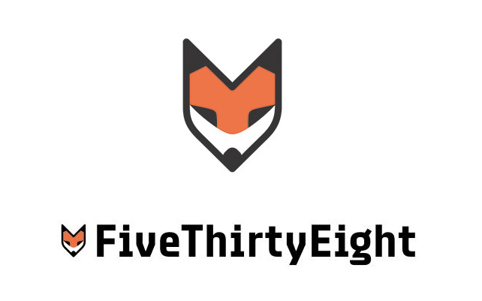

Data Overview
The data was collected from:
FiveThirtyEight.com
Structured Data
Twitter
Semi-Structured
TrumpTwitterArchive.com
Semi-Structured
Python libraries used:
Numpy
Pandas
Matplotlib
Datetime
NLTK
Plotly
JSON
WordCloud
Tweepy
SciPy
TextBlob
Source: https://www.emblemetric.com/2014/03/24/fivethirtyeights-new-logo-by-the-numbers/
Source: https://www.flaticon.com/free-icon/twitter_124021/
3

Slide 4
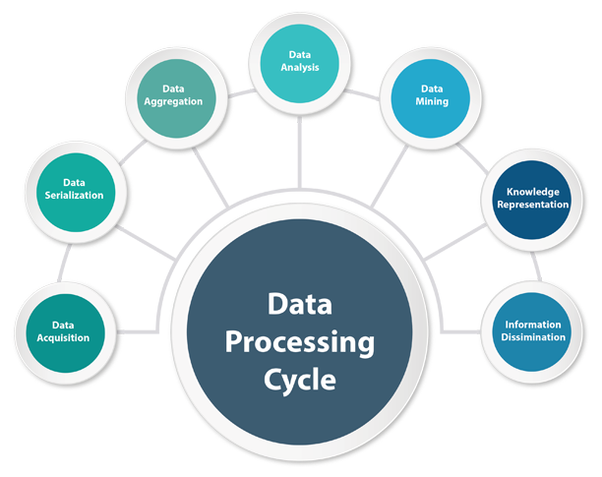
Data Process
1. Data Retrieval
2. Data Preprocessing
3. Text Processing
4. Execute Sentiment Analysis
5. Build Data Frames
6. Produce Models
7. Run Analyses
8. Visualize Key Findings
Source: https://www.google.com/url?sa=i&url=http%3A%2F%2Ftheoceanetc.com%2Fdata-processing%2F&psig=AOvVaw3A28VpHcnJ9PoI-wmipiaF&ust=1599095959240000&source=images&cd=vfe&ved=2ahUKEwjryJXmpsnrAhXvSzABHXSeCgUQr4kDegUIARDlAQ
4

Slide 5
Investigative Questions
How is each candidate trending in the polls over a series of time?
Which candidate is leading in the key swing states?
Which states are a ‘slam dunk’ for a particular candidate to win based on most recent poll data (July 23, 2020)?
What are the most common words associated with hashtags popular with each party?
What is the overall sentiment for each hashtag/political party?
How do retweets and favorite counts trend over time for the two candidates?
Is there a correlation between candidate poll percentage and retweets/favorites?
Can we predict which candidate wrote a given tweet?
5

Slide 6
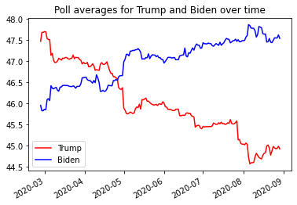
Overall Poll Performance Over Time
Question 1 - How is each candidate trending in the polls over a series of time?
Poll averages favored Trump until late April
Biden has taken the lead and continues to trend upwards while Trump trends down
Poll averages for Trump and Biden from February 27, 2020 to August 29, 2020.
6

Slide 7
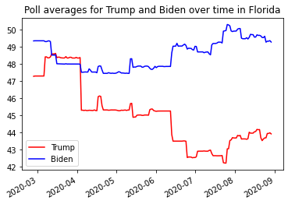
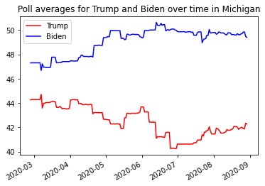
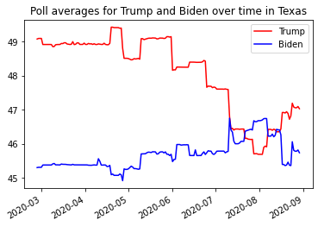
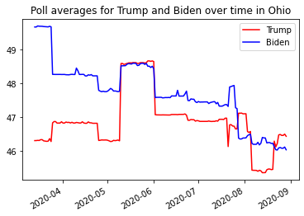
Performance in Swing States
Question 2 - Which candidate is leading in the key swing states?
Biden has the lead in Florida and Michigan
Trump leads in Texas and Ohio
Poll Averages for Trump and Biden in possible key states.
7

Slide 8
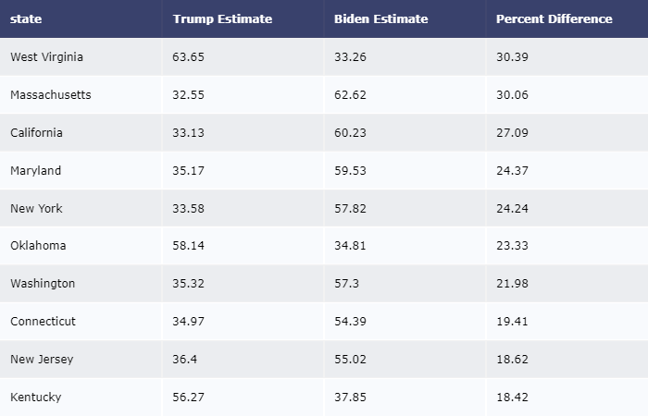
Most Likely to Win - States
Question 3 - Which states are a ‘slam dunk’ for a particular candidate to win based on most recent poll data (August, 29 2020)?
Trump is very likely to win WV, OK, and KY
Biden is very likely to win MA, CA, MD, NY, WA, CT, and NJ
Top 10 states with the largest percent difference between both candidates
8

Slide 9
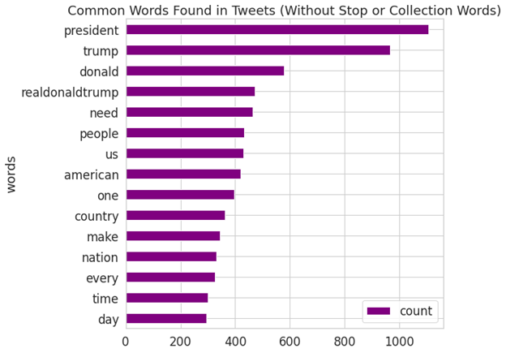
Word Counts
Question 4 - What are the most common words associated with political tweets, based on common hashtags for each party and their candidate?
A bar chart of the most common words associated with the presidential candidate tweets from August 28, 2019 to August 20th, 2020.
9

Slide 10
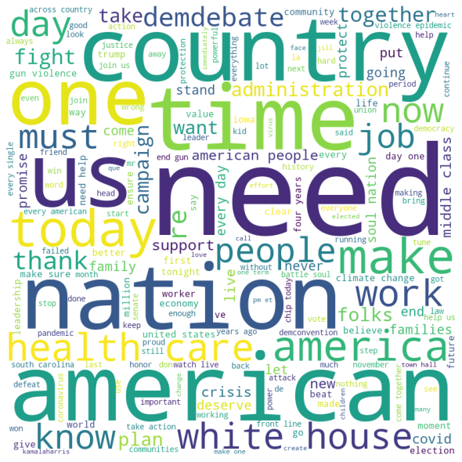
Joe Biden Word Cloud
English stop words removed
Custom words removed related to candidate names
Noticable difference from Donald Trump
Health care
The middle class
Debates
Climate Change
Gun laws
Softer future oriented language
COVID
A word cloud of the most common words associated with Biden tweets from August 28, 2019 to August 20th, 2020.
10

Slide 11
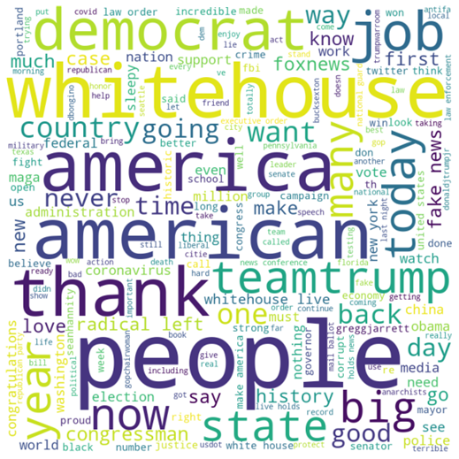
Donald J. Trump Word Cloud
English stop words removed
Custom words removed related to candidate names
Noticable difference from Joe Biden
Whitehouse
Jobs
Military
Thanking the people
Democrats/far left
News/Fake news
Coronavirus
Law & Order
Portland
Police
A word cloud of the most common words associated with Trump tweets from May 21st, 2020 to August 20th, 2020.
11

Slide 12
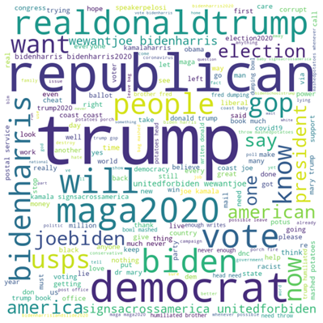
Tweets Associated with Republican and Democrat Parties
English stop words removed
Words converted to lowercase
Punctuation and non-useful words removed
Key themes:
Campaign slogans
USPS
Racism
Hope
Democrat slogan variability
Trump at the center
A word cloud of the most common words associated with tweets referencing key words associated with the republican and democrat campaigns
12

Slide 13
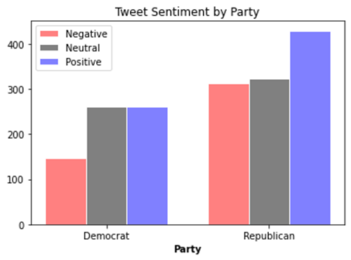
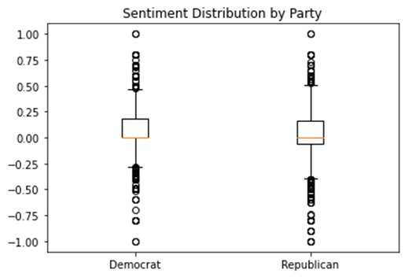
Sentiment Analysis
Question 5 - What is the overall sentiment for each hashtag/political party? Are there any statistically significant differences?
Results indicated that tweets that mention democrat hashtags had a higher average sentiment overall of .06 as compared to the .03 for republicans (p<.05).
Top - Tweet Sentiment by Party
Bottom - Sentiment Distribution by Party
13

Slide 14
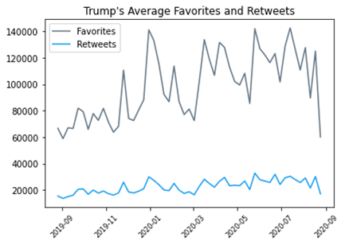
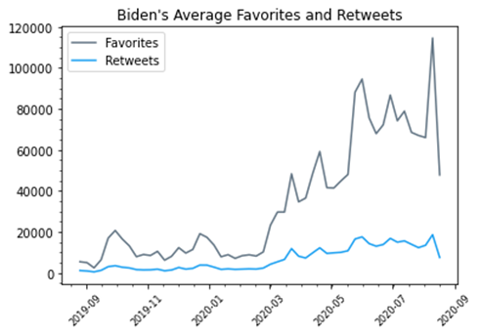
Retweets and Favorites
Question 6 - How do retweets and favorite counts trend over time for the two candidates? Are there differences between the two?
Trump averaged higher favorites and retweets and has stayed fairly consistent over time
Biden showed a lower initial average of favorites and retweets but has shown an increase after key socio political events that have transpired over the course of 2020
Average Twitter favorites and retweets for Trump and Biden from August 28, 2019 to August 20, 2020.
14
Notes:
Question not on slide but part of project - Do tweets from Donald Trump get more retweets and favorites than Joe Biden?
Average favorites for Trump: 96453.07 Average favorites for Biden: 33269.89 Average retweets for Trump: 22296.34 Average retweets for Biden: 6546.78

Slide 15
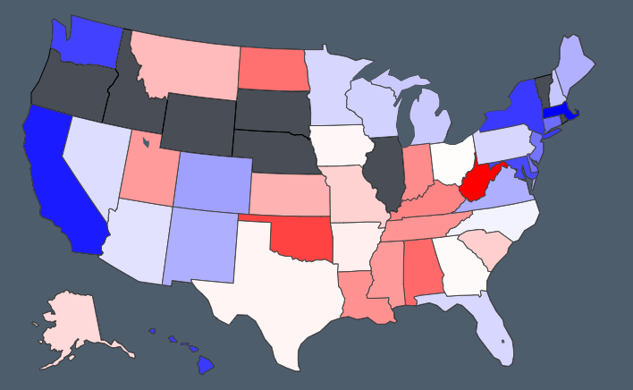
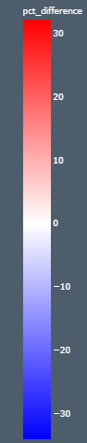
Predicted 2020 Election Results
Biden leads in ‘swing states’ although the race has tightened
Some states not reporting data
Data indicates a Biden-Harris lead
Choropleth map showing predicted 2020 election results by state.

Slide 16
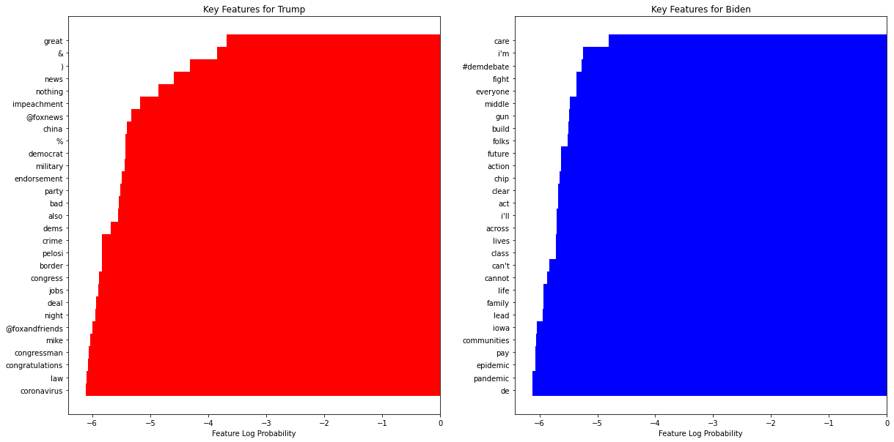
Classifying Candidate Tweets
8,518 total tweets
Multinomial Naive Bayes model
5-fold cross validation
Results:
Precision: 90.7%
Recall: 90.3%
Key Features for Trump and Biden

Slide 17
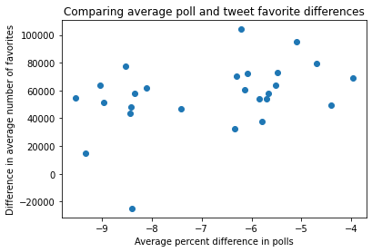
Correlation Between Twitter Favorites and Poll Estimates
The Twitter tweet favorites and FiveThirtyEight poll estimation data were aggregated by week and joined together
Net differences were calculated between Biden and Trump favorites and poll estimations (Trump-Biden)
A statistically significant positive correlation was demonstrated so that as a candidates’ favorites on Twitter increases, so does their percent estimation in the polls
15% of the candidates’ poll average differences are accounted for by the differences in their tweet favorites
Comparison of the difference in average polls and favorites for each candidate.
Notes:
r = 0.39, barely at 0.05 significance
15% of the candidates' poll average differences are accounted for by the differences in their tweet favorites at 0.05 significance

Slide 18
Conclusions
Donald Trump and Joe Biden have clearly distinguishable speech patterns and campaign focus areas
Joe Biden has taken the lead in the election and widen his gap as 2020 has progressed
This advantage has carried into crucial swing states
Sentiment around the Democratic party tweets have had higher sentiment
A correlation exists between Twitter favorites and campaign popularity so that as the difference between
Results can be further improved through greater utilization of the Twitter API, incorporating multiple social media and polling platforms, tracking party growth and campaign donations.

Slide 19
Thank You!
Any Questions?
Designed by PoweredTemplate.com
19

